Slide 1
Project Planning
Team Based Project ( MOD008917 )

Slide 2
Project Planning
Project Planning is when you define the project’s objectives, scope, and procedures and creating a plan of how the project will be executed.
Key Factors:
Scope: Clearly outlining the boundaries (or limits) of the project.
Task Breakdown: Identifying all the tasks required to complete the project.
Scheduling: Establishing timelines for each task.
Resource Allocation: Determining the resources needed for each task.
Milestones and Deliverables: Establishing key milestones to track progress.
Risk Management: Identifying potential risks and finding ways to mitigate them.

Slide 3
Scope
Scope is the definition of what is included in the project, and what is excluded in the project.
Usually, the client can give you scope, or your employer can set the scope.
In this instance the client is giving you the scope of the project. However – you need to decide the limits of the learning content you make.
Start small, you can expand if you have time.
Your manager (lecturer) can help you in judging this.

Slide 4
Task Breakdown
The first step is creating a requirements specification which we covered in lesson 1.
Initial “setup tasks” or research might be identified and need listing.
Each requirement from the specification is then broken down into individual tasks and listed.
Finally, any “takedown” tasks might be identified and listed.
Example: Contract to make a website to register for university.
Setup – hosting, coding language, design work…
Implementation – code login, code home page, code database connection, testing…
Takedown – copyright handover, help and development documentation…
Notes:
You will do this next week but expect it to be a long list!

Slide 5
Scheduling and Resource Allocation
Scheduling is the hardest part to get right, or close to right, and it ties in with your human resource availability.
“Connecting 3 new classrooms to the network will take 5 hours per room.”
5 x 3 = 15 man-hours to complete the task.
The workload can be shared between 3 people. This will take 5 hours real time.
“Painting the hallway will take 15 hours for one person.”
We have 3 people available, but only 2 can fit in the hallway at any one time.
The workload can be shared between only 2 people. This will take 7.5 hours real time.
Notes:
We’re ignoring physical or monetary resources for this.

Slide 6
Timescales and Buffer
“No plan survives first contact with the enemy.”
Useful Tips
Add a safety buffer to the timescale for every task (or group of tasks).
The average appears to be about 20% extra time.
For mission critical tasks (e.g. legal requirements) you might increase it.
If somehow you don’t use that buffer time – expand the project!

Slide 7
Milestones and Deliverables
On your project schedule you mark on any dates for major milestones or deadlines to deliver content.
This lets you check your plan will complete within the required times (e.g. if implementation isn’t complete by Software Handover milestone, something is wrong).
It also gives you visibility and reminders of major planned events.
Notes:
We’re ignoring physical or monetary resources for this.

Slide 8
Gantt Charts
Notes:
Each row is a task.
Each coloured bar is a timescale.
Tasks can run one after the other (testing cannot start before development is complete).
Tasks can run concurrently (developing a database can happen at the same time as a website).
You will need to create one of these for your project to keep things on track.

Slide 9
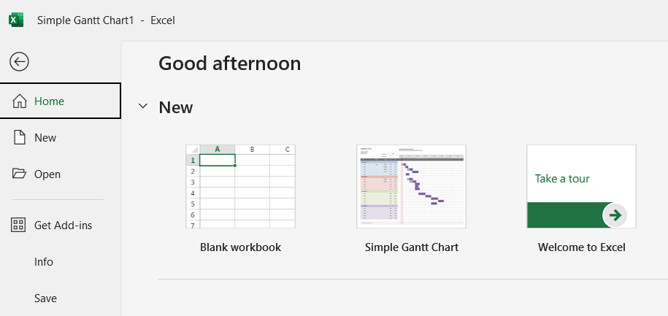
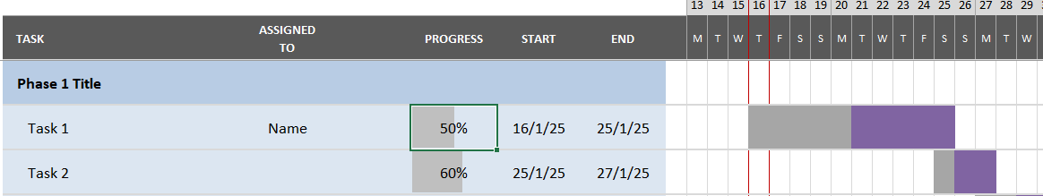
Gantt Charts in Excel
Excel has simple built-in Gantt charts.
You can then just rename the tasks and change the start and ends.

Slide 10
Activity 1 (Teams - 15 minutes)
Here is the task list and schedule for a planned university event. Convert it into a Gantt chart:
Book Venue – Start 20th Jan, duration 3 days
Arrange Catering – Start after booking venue, duration 3 days
Invite Guest Speaker – Start after booking venue, duration 5 days
Promote Event – Start after both catering and speaker sorted, duration 11 days
Manage Registrations – Start with promoting event, duration 16 days
Set Up Venue – Start 11th Feb, duration 1 day
Run Event – Start 12th Feb, duration 1 day
Clean Up After – Start day after event is run, duration 1 day

Slide 11
Risk Management
Team Based Project ( MOD008917 )

Slide 12
What is Risk Management?
All projects have risks. Small risks might just be accepted. Big risks need mitigating to make them small risks.
A risk matrix helps you list and document the risks and how big they are.
A SWOT analysis can help you identify additional risks.
Notes:
You will need to create at least a risk matrix for your project.

Slide 13
SWOT Analysis
Strengths | Weaknesses | Opportunities | Threats
What are you all good at? | What skills are you missing? | What could go great? | What could go wrong?
The Weaknesses and Threats columns are your risks.
There are many templates for SWOT analysis, but a table is simplest to create.

Slide 14
Risk Matrix
Risk | Likelihood | Impact | Overall | Mitigation
What is the risk? | How likely is it to happen? 1 (low) - 5 (high) | How bad would it be if it happened? 1 (ok) - 5 (bad) | Likelihood x Impact 1 (low) - 25 (high) | How can we avoid it?
Meteor Strike | 1 | 5 | 5 | n/a
Team member taken ill. | 3 | 3 | 9 | Build in buffer time.
Report file corrupts. | 3 | 5 | 15 | Regular backups.

Slide 15
Activity 2 (Teams - 15 minutes)
Create a Risk Matrix and categories each of the following hypothetical risks to a business project. Include methods to mitigate it if applicable:
Team member goes off long term sick.
Servers get hacked and all work is lost.
Competitors learn of the project and start their own.
Team does not have the coding knowledge required.
Customer brings deadlines forward.
Delivery of required hardware to site is delayed.
Asbestos is found in the client site.
Pandemic declared with lockdown procedures.
Notes:
Note: there can be completely wrong answers (a category 5 hurricane is NOT a minor impact!) but there is no exact right answer.

Slide 16
Agile Development
Team Based Project ( MOD008917 )

Slide 17
What are Software Dev Lifecycles?
A software development lifecycle is the overall process used to run a software project from initial idea through to deployment.
There are 3 major ones and 1 hybrid monster (which is used more than people admit!):
Waterfall
V-Model
Agile
Water-Scrum-Fall

Slide 18
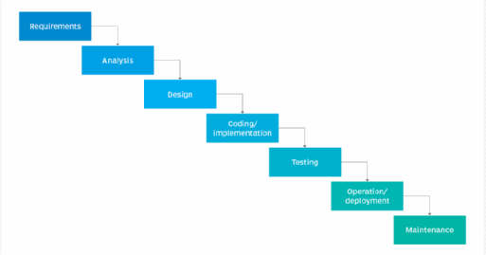
SDLC: Waterfall
Notes:
Waterfall was the original, the first, the one that has long since fall out of favour.
Pros:
Clear structure and requirements defined early.
Easy to manage and track.
Usually extensive documentation for future work.
Cons:
Not great at coping with change so assumes requirements won’t change halfway through.
Tests at the end so could find this but be unable to fix.
Customers only involved at the start.
Long projects could be obsolete before complete.

Slide 19
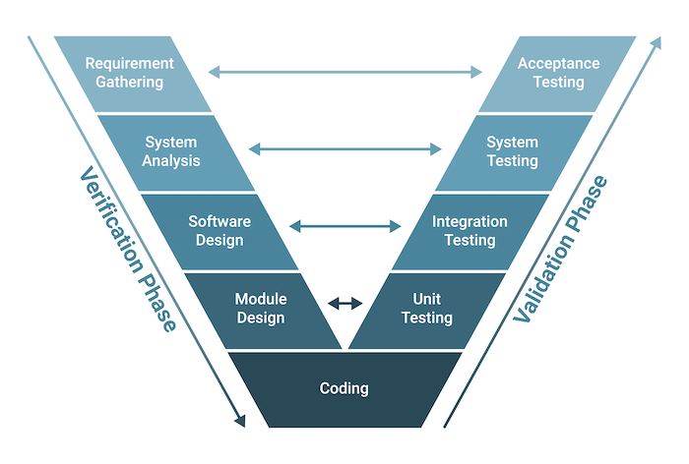
SDLC: V-Model
Notes:
Next up was V-Model.
Pros:
Easy to understand and manage.
Testing works in parallel with development phases, allowing for early detection of bugs.
Focus on validation to meet requirements and standards
Extensive documentation for future reference.
Cons:
Doesn’t cope well with change and assumes requirements won’t change halfway.
Integration is done late which can mean hard to fix issues.
Customers only involved at the start.

Slide 20
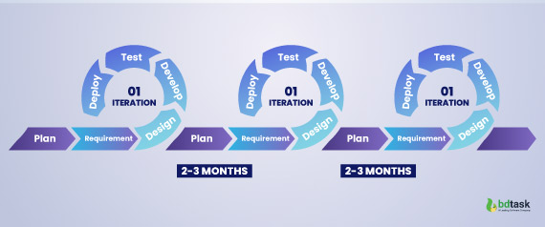
SDLC: Agile
Notes:
Pros:
Allows for changes in requirements even late in the development process.
Regular feedback and iterative development ensure that the product evolves based on user needs.
Lots of customer involvement, ensuring that the final product meets their expectations.
Faster more regular releases.
Cons:
Hard to predict timelines, costs, and resource requirements.
Requires a lot of customer involvement.
Doesn’t always consider documentation for future reference.
Relies heavily on a good team, not great if they don’t like each other.
Faster more regular releases – not every customer wants this!

Slide 21
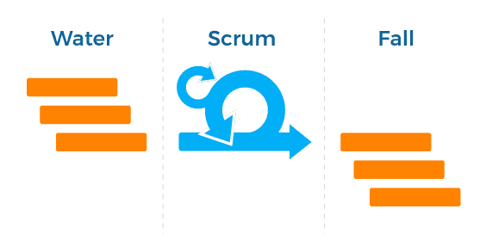
SDLC: Water-Scrum-Fall
Notes:
Pros:
Best of both worlds, including the structure of Waterfall with the flexibility of Scrum.
Development is flexible and iterative so can adapt to change.
Clear milestones and initial planning help ensure that the project stays on track.
Cons:
Hard to manage merging 2 methodologies, especially if over multiple teams.
Need to balancing the documentation requirements of Waterfall with the working software focus of Agile.

Slide 22
What is Agile Development?
Agile is a software development methodology with a focus on adaptability and being able to respond to changes throughout a project: www.agilealliance.org
There are many sub-methods of Agile used in industry, both standalone and in a pick-n-mix format:
Scrum
Kanban
Feature-Driven Development
Extreme Programming
Notes:
We will look at Scrum and Kanban more in a bit because we’re using both of their processes for this project – they work well together.
Feature-driven development is a focus on developing a program one feature at a time. Imagine a first-person-shooter game. FDD means you would first work on making the character move, then release. Next maybe make them shoot, then release. Then implement health, then release.
Extreme programming development is a method with very specific ways of coding such as teams sat together and pair-programming, a focus on testing and refactoring code as well.

Slide 23
12 Principles of Agile
Early and continuous delivery of valuable software.
Welcome changing requirements, even late in development.
Deliver working software frequently, preferring a shorter timescale.
Businessmen and developers must work together daily.
Have motivated team members.
The best communication is face-to-face.
Working software is the primary measure of progress.
Sustainable development.
Continuous attention to technical excellence and good design.
Simplicity is essential.
Have self-organising teams.
At regular intervals, reflect and adjust.

Slide 24
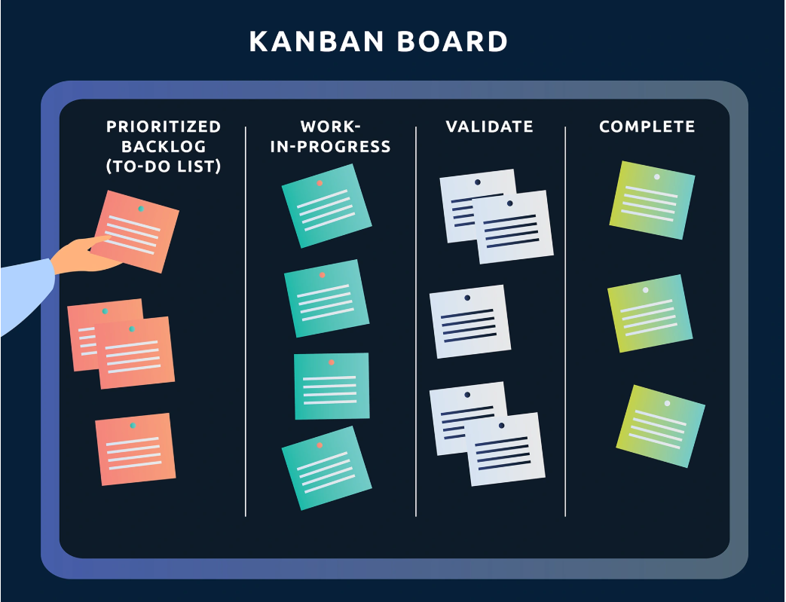
Kanban
Kanban was started by Toyota in Japan. They used cards to show the flow of tasks from start to finish through production.
This is used in a lot of software development companies as it is very easy and simple to see the status of tasks and identify bottlenecks.
Notes:
Quick look at Kanban as we’ll use it more next week – you will be making your own board to keep track of your workload.

Slide 25
Scrum
The Scrum method uses specific processes to manage their agile-ness:
Sprints
Sprint Planning
Daily Scrum (AKA standup)
Retrospectives
Backlogs
The Scrum method has specific team roles:
Product Owner
Scrum Master
Development Team

Slide 26
Sprints
Sprint: A short period time in which to complete development tasks.
Sprint Planning: A meeting just before the start of a sprint, where the team agrees what tasks go into the Sprint.
Daily Standup: A quick get together of all team members to update each other on how their tasks are going, and an opportunity to request help if needed.
Retrospective: A meeting where the team discuss what worked and what went wrong, with the aim to improve it next time.

Slide 27
Sprints And You
Sprint: Your sprints will be 1 week in duration, starting in Week 3.
Sprint Planning: You will (normally) do sprint planning in Lesson 1 each week throughout the project, starting in Week 3.
Daily Standup: You won’t do a daily standup, but you will have a quick standup including your manager (lecturer) every Lesson, starting Week 3.
Retrospective: You will do a short retrospective each week before the start of your sprint planning (normally) in Lesson 1 each week, starting Week 4.

Slide 28
Backlogs
A backlog is purely a list of all the tasks left to be completed in your project.
A project backlog is everything left to do in the entire project.
A sprint backlog is everything assigned to the sprint left to do.
You will create your backlogs in Week 2 and use Kanban board tools to manage it.

Slide 29
Scrum Roles
Product Owner: Person in charge of the backlog and advocating for the customers when deciding what features or tasks get done next.
Scrum Master: The person responsible for making sure the team are following the Scrum processes and generally get charged with running the meetings.
Development Team Member: Anyone. You can be a test specialist, a network installer, or a coder. If you are in the team, you are a “developer”.
Notes:
Good news! Everyone is going to take a turn at being Scrum Master for at least a week!

Slide 30
Activity 3 (Teams - 20 minutes)
In your teams, go through everyone’s schedule and create a rota of who will be Scrum Master each week, including a deputy.
Scrum Master will be responsible for leading the retrospective, sprint planning, and the standup meetings with the manager (lecturer).
If team members are away, the Scrum Master will provide that person’s update during the standup.
Email your rota to your manager (lecturer) for reference.
Everyone must be Scrum Master at least once throughout the project.
Notes:
Things happen and people get sick for example. If the Scrum Master gets sick, the deputy takes over for that week.

